Slide 1

Fallopian Eggscapade
By Kaisha Gerhardt

Slide 2
Welcome to the jungle
Lets just flow right into it, this is a game about the menstrual cycle.
We start with a single egg that has a big journey ahead of him.
The time of the month is approaching and the eggs ready themselves to travel the natural wonders that the cavern of the uterus hold.
Collect 20 estrogen hormones to complete the cycle
Progesterone will lower your estrogen levels
Stay away at all costs from the swimmers

Slide 3
Characters & Collectables

Slide 4
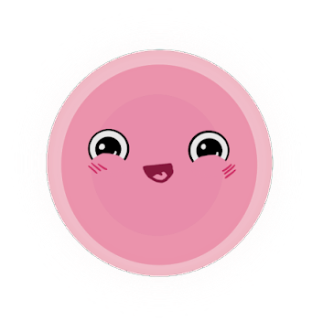
Eggy Ovum Player
Eggy is the eagerly eggcided ovarian egg that plans to make the journey to the vaginal canal in order to announcements for the body.

Slide 5

EggBert
Eggbert is an NPC who is a but older than the rest of the eggs. As the elder, he teaches the younger eggs where to travel and what to watch out for. He’s been in the ovaries longer so he’s oxidizing.
“Remember Eggy, estrogen is what keeps us going. Stay away from progesterone, they can stop us from completing our cycle!
Eggy, by all accounts, stay away from the Swimmers! Just one will destroy our very existence and create something of a problem that could last for 18 years!”

Slide 6
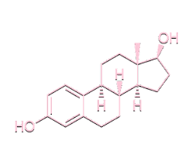
Estrogen
Estrogen is the main ingredient that the eggs need to gather in order to come their cycle. Collecting estrogen will be equivalent to collecting health.
Estrogen plays a role as it thickens the lining of the uterus to prepare for pregnancy.

Slide 7
Enemies

Slide 8

Swimmer
Swimmers are the main antagonist in this story.
Swimmers are semen, and their goal is to knock up Eggy’s journey.
The player has to avoid the swimmers at all times, the game will end if they are touched by one. It only takes one

Slide 9
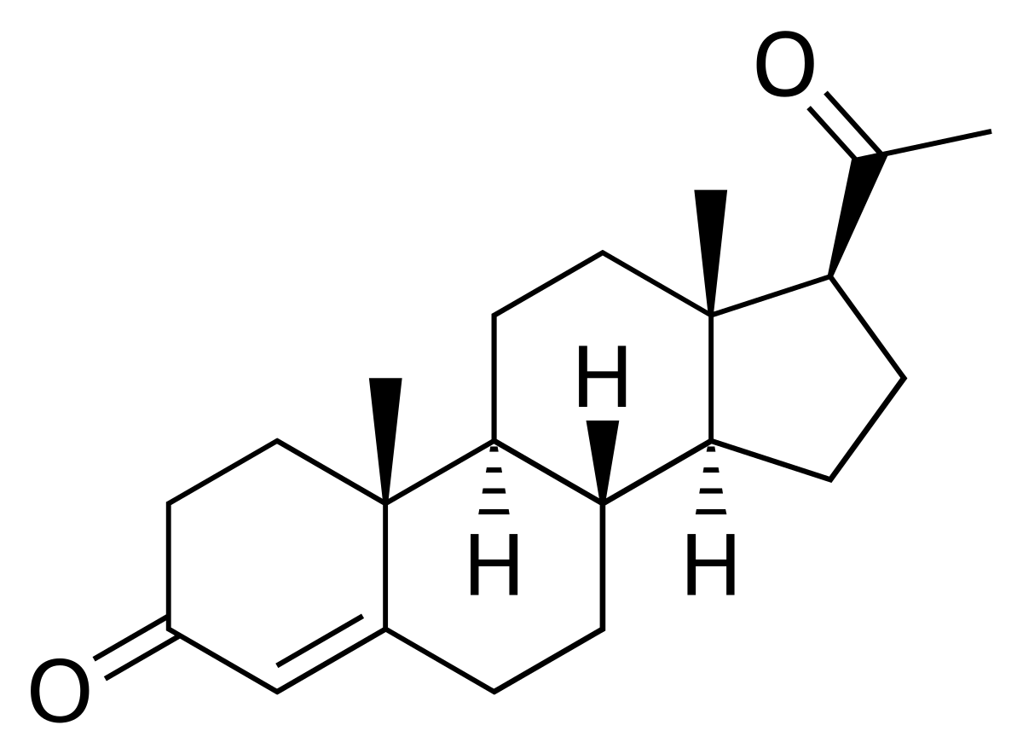
Progesterone
Progesterone is the chemical eggy should avoid while traveling.
A lot og progesterone has the ability to cause the muscles to contract in the future that causes the body to reject an egg. Which is found in birth controls.
So in order for egg to complete his cycle. Getting hit by the progeestine will cause your estrogen levels to decrease.

Slide 10
Other NPCs, Collectables, or Enemies
NPCS or Possible Players: Tampons, Birth Control pills, Nexplodon, and IUD, medications for yeast infections.
Collectables: Birth control chemicals,
Enemies: Bacteria that causes UTI, Toxic Shock element, Yeast infection
More ideas on the way…

Slide 11
Assets
Well… the other things that aren't interactable

Slide 12
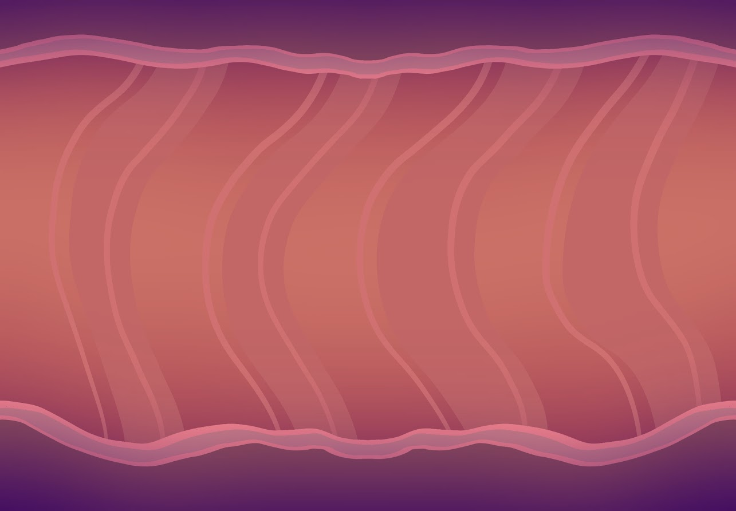
Background

Slide 13

Foreground

Slide 14
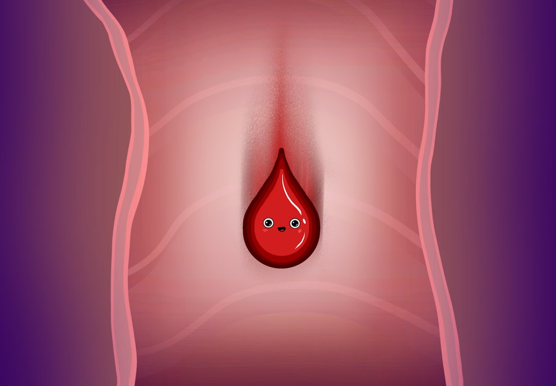
Current End Background

Slide 15
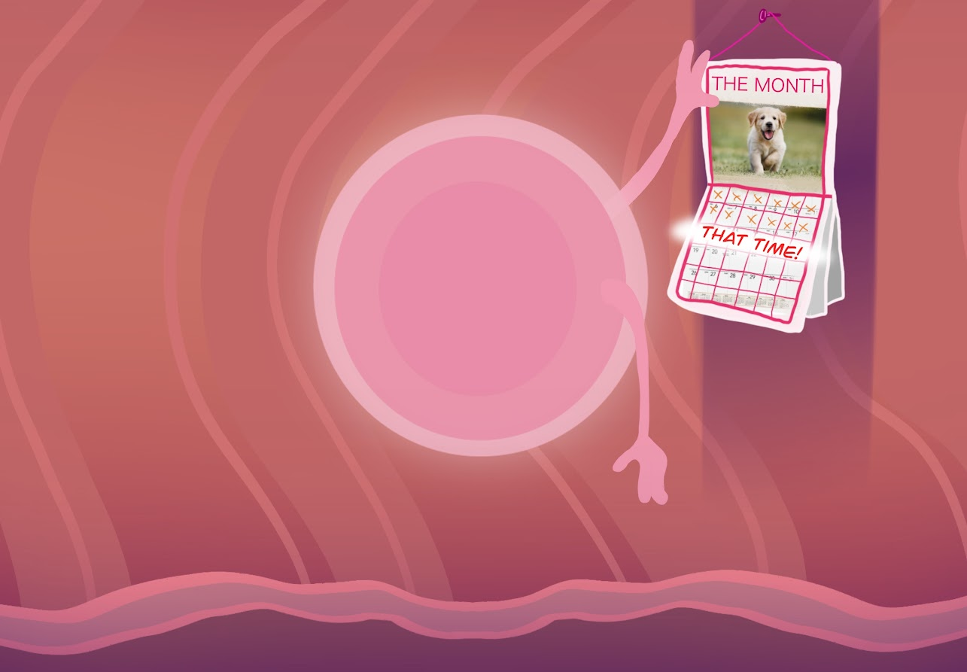
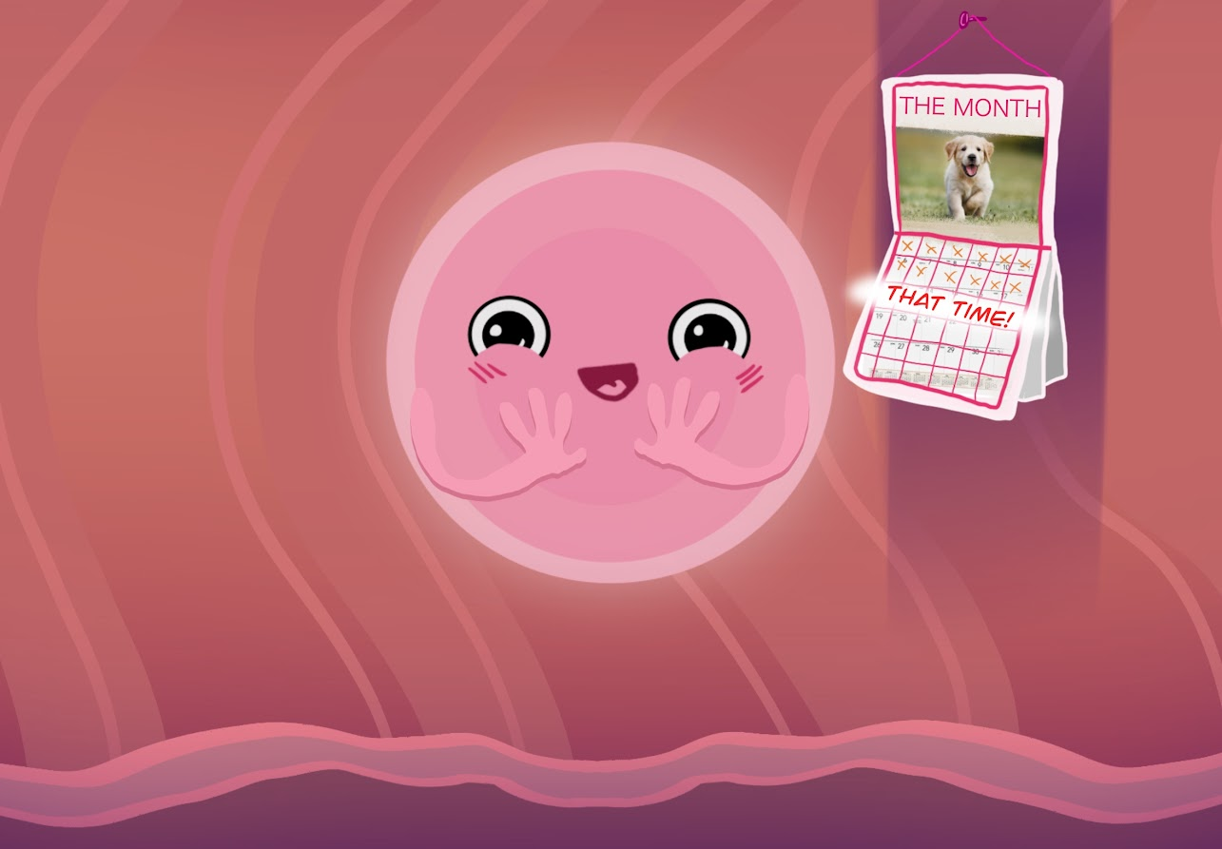
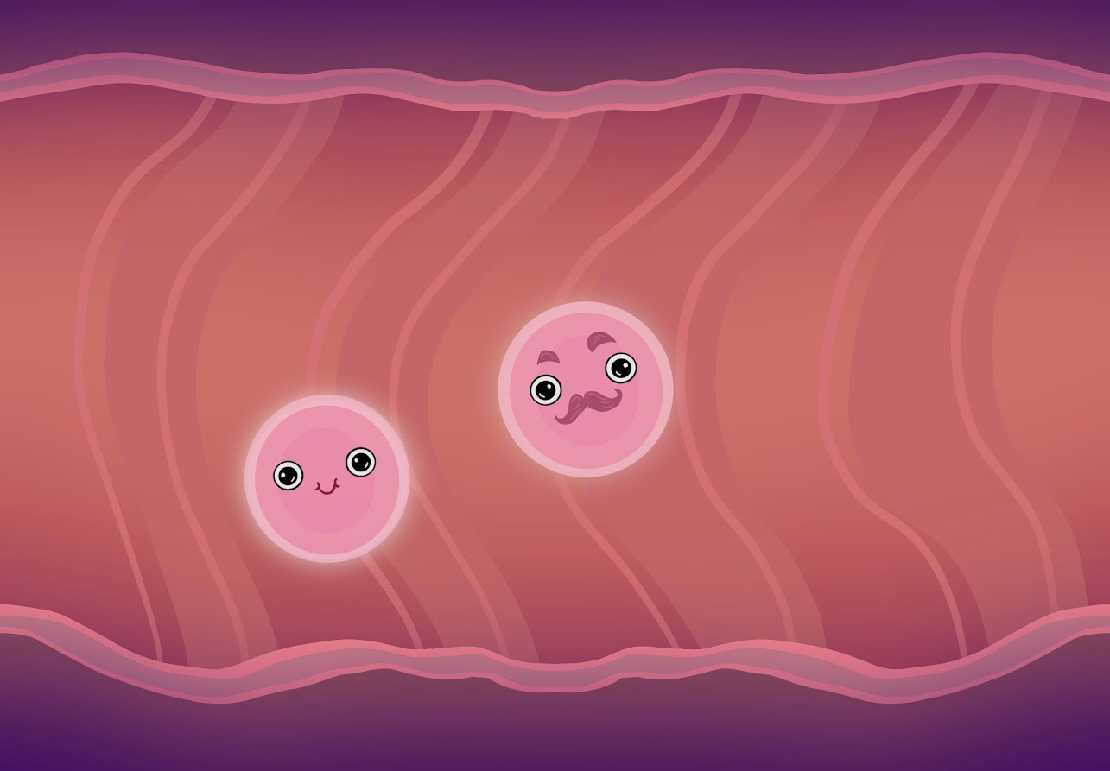
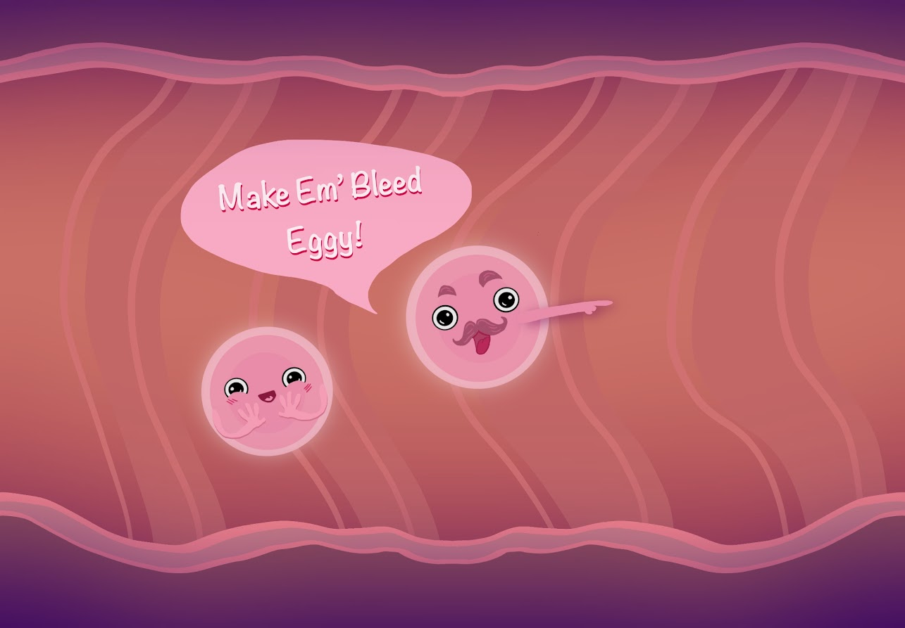
Current Storyline:

Slide 16
Goals
For the project

Slide 17
Creating an Educational Experience
The game started out as a little funny moment, but the aspect of the game has shifted into more than I expected.
I strive to create a informative game that teaches people about the menstrual cycle, sex and female organs in a way that is aesthetically pleasing.
Have it cute, funny and educational.

Slide 18
Ways for becoming more educational
I plan to have several different levels for the game. Each level would provide the player a new aspect of a period to learn about. Such as, you unlock certain levels where you play as different characters and face different enemies.
Example:
The player is an IUD that must protect the ovarian tubes from having swimmers get inside.

Slide 19
The future for the game
I hope to make this a simple game that has the potential to be used in educational environments. Steam would be a base platform to have it start on.
I think the best way for this to reach its potential is to present it to educational platforms and offer it free to players of all ages.
I want an large audience to have access to it, so having it be free in the beginning would offer that ease for players.
PC and Mobile gaming would be the best platform so far with the style of game.

Slide 20
Progress
So Far
Sorry in advance for the poor video and audio quality

Slide 21


Slide 24
Alternating:
Audio will be shifted due to copyrights
Maybe add sound effects
There are many IFs, ANDs and BUTs so far into the process
Just like the game, this presentation isn’t really finished

Slide 25
UPDATES

Slide 26
Update Questions
Update on implementation details.
Specify how your timeline has changed. Include your old timeline and your new timeline if changed. Be as specific as you can be with your timeline.
Include achievement components, social components, and immersion components of your game.
Discuss the skills required in your game
What the goals are of the game (how will the players know what the goals are)
What is the constant feedback that your game provides to the players?
How does your game make players less self-absorbed?
Keep in mind that your game might not hit all of these. Indicate which ones are applicable and which ones are not. Justify the ones that aren't applicable.

Slide 27
Update on implementation details
Not going to lie. The Implementation has been “Go with the flow”
Implementation of the game has been shifting around. The overall idea is to get a demo that works and is enjoyable to play, show it to as many people and if it seems to be a hit then, find platforms to allow people to play it. I would want it to be free so there is no limit for those who wish to play it. I wish for the demo to be in the UM Expo so that it may get some player’s review and see what could be changed or added in order for it to be good enough to be placed on streaming platforms.

Slide 28
Specify how your timeline has changed
There previously wasn’t much of a consistent timeline, due to not knowing which project I was going to switch my attention to. Here’s is the freshest timeline for the game: Goal Dates -
Nov. 22 - Have all additional assets created (Collectables and Enemies)
Nov. 27 - Have Demo slightly functioning for first level
Nov. 30 - Be functional with the first level
Dec.11 - Add levels and tweak functionality for demo - Turn in for EXPO
Dec. 14/15 - Polished and have more than one level playable with ending

Slide 29
Include achievement components, social components, and immersion components of your game.
Achievement components: The achievements that the game will offer is if the player reaches a high point in estrogen or reaches a certain level, they will unlock teams for Eggy. Items such as hats, weapons(birth control) or new faces (like add an eggstache)
Social Components: On the social scale, it would be an entertaining future if the game was to switch to having an online access, where others can players can race another online as other the eggs or swimmers! It would create a link for a social aspect of the original gameplay.
Immersion Components: I mean to use characters as a method of immersion for the players. To help teach through the levels and explain why the players is doing what the player does. For a more physical immersion, having achievements can grapple the attention of players.

Slide 30
Discuss the skills required in your game
For the game, I would like there to be no skill needed to play. The gameplay motive is to avoid and collect. The levels for the game will progressively get more and more complicated but with time and practice, people will get a hang of it and create the potential for beating all the levels in the game.
The game is on the educational motive, so having a minimal skill requirement allows a more wider audience to enjoy and play the game.

Slide 31
What the goals are of the game (how will the players know what the goals are)
The overall goal is to create an entertaining method of learning the functionality of women reproductive organs.
The goal for the players is however, is to have fun and gain information/knowledge that way. So the game isn’t forcing info upon people, its inviting them.
For the player: They create their goal on how to win the level. Each level wil range On motives but the overall goal is to avoid and collect. They’ll understand the goal, bluntly through the NPC ( Eggbert) who will help players and guide them on what is best to get and stay away from

Slide 32
What is the constant feedback that your game provides to the players?
The feedback for players, is accomplishment of gaining new level ups, new collectibles. As I’m typing this, I just now thought that there could be another add-on where if players reach a certain collected amount of estrogen; that will lead to unlock weapons (types of birth control) and outfits (condom hat) for the main player (Eggy). To help create a drive to continue playing on.
Another interpretation of the question: The other feedback /m that they are learning while they play! Maybe have Eggbert remind them what they subconsciously learned during the level.

Slide 33
How does your game make players less self-absorbed?
Hopefully no.
The game is to invite and excite everyone and learn something they may not understand that well. However, I am aware that people tend to get extremely competitive so having unlockables at certain levels could lead to pompous attitude.
That’s not the goal, the wish is to have players keep the mind open and aware. There is no NPCs that may help with empathy but overall game depiction is to show the meaningfulness of the subject matter.

Slide 34
THE GAME TRAILER
https://youtu.be/thbHiCX6vyI

Slide 35
Thank You
For your time!

